Slide 1

MC9510- Modelling in Operations Research Probabilistic Operations Research Models
T. Mayooran,
Department of Interdisciplinary Studies,
Faculty of Engineering,
University of Jaffna.
Email: mayooran@eng.jfn.ac.lk

Slide 2
Tentative Plan: Probabilistic Operations Research Models
10 – 07 – 2023 Lecture class
11 – 07 – 2023 Lecture class
13 – 07 – 2023 Lecture class
17 – 07 – 2023 Lecture class
18 – 07 – 2023 Lecture class
20 – 07 – 2023 Lecture class
24 – 07 – 2023 Lecture class
25 – 07 – 2023 Assignment Exam
27 – 07 – 2023 Lecture class

Slide 3
Probabilistic Operations Research Models
Queuing problems Arrival process
The Poisson process
Queues-general notations
Queues-special types
Memory less queue calculations
Economic analysis
Systems of multiple queues
Comparing and optimizing queuing systems
Pseudo-random number

Slide 4
QUEUING THEORY or WAITING LINE ANALYSIS

Slide 5
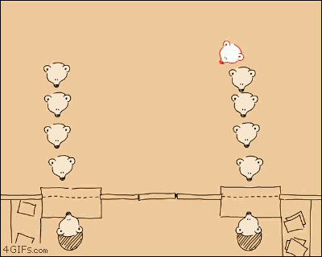
Stay in Queue:
Something we can all relate to…☺

Slide 6
Queuing Theory Introduction
Definition and Structure
Characteristics
Importance
Models
Assumptions
Examples
Measurements
Apply it to SCM

Slide 7
What is the Queuing Theory?
Queue- a line of people or vehicles waiting for something
Queuing Theory- Mathematical study of waiting lines, using models to show results and show opportunities within arrival, service, and departure processes

Slide 8
Structure
Input source
Queue Discipline
Service Facility
Served Customers
Balking Customers
Reneging Customers

Slide 9
Customer Behaviors
Balking of Queue
Some customers decide not to join the queue due to their observations related to the long queue length, insufficient waiting space or improper care while customers are in the queue. This is balking and, thus, pertains to the discouragement of customers for not joining an improper or inconvenient queue.
Reneging of Queue
Reneging pertains to impatient customers. After being in queue for some time, a few customers become impatient and may leave the queue. This phenomenon is called as reneging of the queue.

Slide 10
Characteristics
Arrival Process
The probability density distribution that determines the customer arrivals in the system.
Service Process
The probability density distribution that determines the customer service times in the system.
Number of Servers
Number of servers available to service the customers.
Number of Channels
Single channel
N independent channels
Multi channels
Number of Phases/Stages
Single Queue
Series or Tandem
Cyclic -Network
Queue Discipline -Selection for Service
First com first served (FCFS or FIFO)
Last in First out (LIFO) -Random
-Priority

Slide 11
Importance of the Queuing Theory
-Improve Customer Service continuously.
-When a system gets congested, the service delay in the system increases.
A good understanding of the relationship between congestion and delay is essential for designing effective congestion control for any system.
Queuing Theory provides all the tools needed for this analysis.

Slide 12
Queuing Models
Calculates the best number of servers to minimise costs.
Different models for different situations
Exponential
Normal
Constant
Etc.

Slide 13
Queuing Models Calculate:
Average number of customers in the system waiting and being served
Average number of customers waiting in the line
Average time a customer spends in the system waiting and being served
Average time a customer spends waiting in the waiting line or queue.
Probability of no customers in the system
Probability n customers in the system
Utilization rate: The proportion of time the system is in use.

Slide 14
Assumptions
Different for every system.
Variable service times and arrival times are used to decide what model to use.
Not a complex problem:
Queuing Theory is not intended for complex problems. We have seen this in class, where this are many decision points and paths to take. This can become tedious, confusing, time consuming, and ultimately useless.

Slide 15
Examples of Queuing Theory
Outside customers (Commercial Service Systems) -Barber shop, bank teller, cafeteria line
Transportation Systems -Airports, traffic lights
Social Service Systems -Judicial System, healthcare
Business or Industrial –Production lines

Slide 16
How the Queuing Theory is used in Supply Chain Management
Supply Chain Management uses simulations and mathematics to solve many problems.
The Queuing Theory is an important tool used to model many supply chain problems. It is used to study situations where customers (or orders placed by customers) form a line and wait to be served by a service or manufacturing facility. Clearly, long lines result in high response times and dissatisfied customers. The Queuing Theory may be used to determine the appropriate level of capacity required at manufacturing facilities and the staffing levels required at service facilities over the nominal average capacity required to service expected demand without these surges.

Slide 17
When is the Queuing Theory used?
Research problems
Logistics
Product scheduling
Ect…

Slide 18
Terminology
Customers: independent entities that arrive randomly at a server, wait for some kind of service, and then leave.
Server: can only service one customer at a time; length of time depends on the type of service. Customers are served based on first in, first out (FIFO)
Time: real, continuous, time.

Slide 19
Queue: customers that have arrived at server and are waiting for their service to start
Queue Length at time t: number of customers in the queue at that time
Waiting Time: how long a customer has to wait between arriving at the server and when the server actually starts the service
Notes:
19

Slide 20
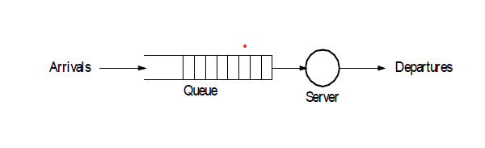
Basic Model

Slide 21
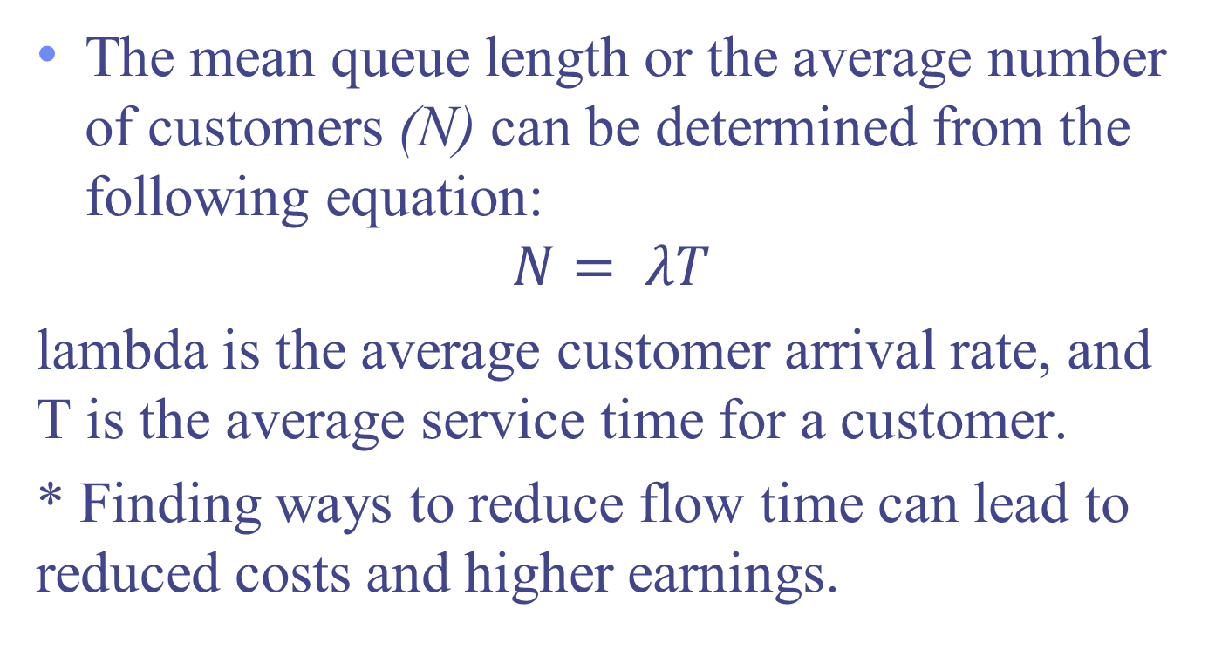
Little’s Law
The mean queue length or the average number of customers (N) can be determined from the following equation:
$$N= λT$$
lambda is the average customer arrival rate, and T is the average service time for a customer.
* Finding ways to reduce flow time can lead to reduced costs and higher earnings.
Notes:
We begin our analysis of queuing systems by understanding Little's Theorem. Little's theorem states that:
21

Slide 22
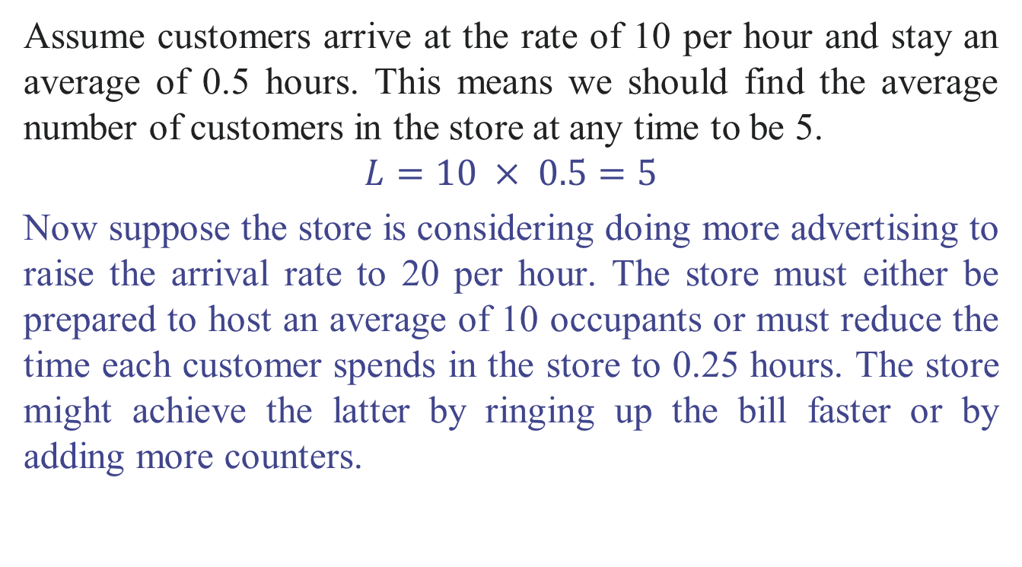
Little’s Law Example
Assume customers arrive at the rate of 10 per hour and stay an average of 0.5 hours. This means we should find the average number of customers in the store at any time to be 5.
$$L=10 × 0.5=5$$
Now suppose the store is considering doing more advertising to raise the arrival rate to 20 per hour. The store must either be prepared to host an average of 10 occupants or must reduce the time each customer spends in the store to 0.25 hours. The store might achieve the latter by ringing up the bill faster or by adding more counters.

Slide 23
Poisson Distribution Poisson role in the arrival and service process:
Poisson (or random) processes means that the distribution of both the arrival times and the service times follow the exponential distribution. Because of the mathematical nature of this exponential distribution, we can find many relationships based on performance which help us when looking at the arrival rate and service rate.
Poisson process. An arrival process where customers arrive one at a time and where the interval s between arrivals is described by independent random variables.

Slide 24
Factors of a Queuing System
When do customers arrive?
Are customer arrivals increased during a certain time (restaurant- Denny’s: breakfast, lunch, dinner) Or is the customer traffic more randomly distributed (a café-Starbucks)
Depending on what type of Queue line, How much time will customers spend
Do customers typically leave in a fixed amount of time?
Does the customer service time vary with the type of customer?
Notes:
Depend on asking questions for example:
24

Slide 25
Important characteristics
Arrival Process: The probability distribution determines the system's customer arrivals.
Service Process: determines the customer service times in the system.
Number of Servers: Amount of servers available to provide service to the customers

Slide 26
Queuing systems can then be classified as A/S/n
A (Arrival Process) and S (Service Process) can be any of the following:
Markov (M): exponential probability density (Poisson Distribution)
Deterministic (D): Customers’ arrival is processed consistently
“N”: Number of servers
“G”: General, the system has “n” number of servers
Notes:
Deterministic: all customers have the same value. Queuing systems are defined in this order.
26

Slide 27
Notation: A/B/x/y/z
• A = letter for arrival distribution
• B = letter for service distribution
• x = number of service channels
• y = number allowed in queue
• z = queue discipline
Notes:
Each letter holds a spot, this is what those spots represent
27

Slide 28
Examples of Different Queuing Systems
M/M/1 (A/S/n)
Arrival Distribution: Poisson rate , M tells you to use exponential probability
Service Distribution: again, the M signifies an exponential probability
1 represents the number of servers
Notes:
1,2,3 arrival and service rate is poisson and there is one server
28

Slide 29
M/D/n
-Arrival process is Poisson, but service is deterministic.
The system has n servers.
ex: a ticket booking counter with n cashiers.
G/G/n
- A general system in which the arrival and service time processes are both random

Slide 30
Poisson Arrivals
M/M/1 queuing systems assume a Poisson arrival process.
This Assumptions is a good approximation for the arrival process in real systems:
The number of customers in the system is very large.
Impact of a single customer on the performance of the system is very small (a single customer consumes a very small percentage of the system resources)
All customers are independent (their decision to use the system is independent of other users)
Cars on a Highway
Total number of cars driving on the highway is very large.
A single car uses a very small percentage of the highway resources.
Each car driver independently makes the decision to enter the highway.
Notes:
This assumption is a good approximation for arrival process in real systems that meet the following rules: By looking at this model we can see that….Since these assumptions are fairly general, it is clear that this system can follow almost any model
30

Slide 31
Summary
M/M/1: The system consists of only one server. This queuing system can be applied to a wide variety of problems as any system with a very large number customers.
M/D/n: Here the arrival process is poisson and the service time distribution is deterministic. The system has n servers. Since all customers are treated the same, the service time can be assumed to be same for all customers
G/G/n: This is the most general queuing system where the arrival and service time processes are both arbitrary. The system has n servers.
Notes:
Arbitrary: determined by chance Poisson: continous time process Type of probability distribution typically used in studies concerned with the count or number of occurrences of events.
31

Slide 32
Pros and Cons of Queuing Theory (END)
Positives
Negatives
Helps the user to easily interpret data by looking at different scenarios quickly, accurately, and easily
Can visually depict where problems may occur, providing time to fix a future error
Applicable to a wide range of topics
Based on assumptions ex. Poisson Distribution and service time
Curse of variability- congestion and wait time increases as variability increases
Oversimplification of model
Notes:
P: Healthcare, traffic, retail stores, banks etc N: assumptions of theory not always true in the real world
32

Slide 33
L I M I T A T I O N S
Mathematical models put a restriction on finding real world solutions
Ex: Often assume infinite customers, queue capacity, service time, In reality there are such limitations.
Relies too heavily on behavior and characteristics of people to work smoothly with the model
Notes:
Mathematical models often assume… Such limitations: Is the company okay with the line extending out into the street, how many people will the building hold? Measure patience, everyone is different
33

Slide 34
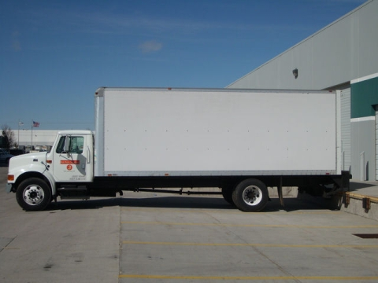
Types of Queuing Systems
Single Channel Single Phase: Trucks unloading shipments into a dock.

Slide 35
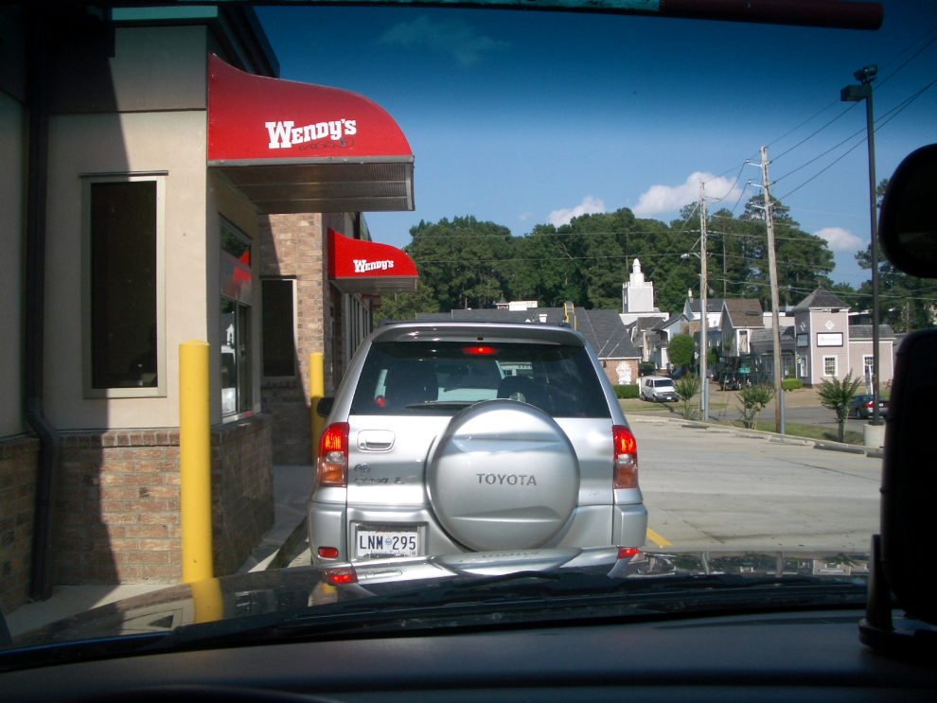
Types of Queuing Systems
Single Line Multiple Phase: Wendy’s Drive Thru -> Order + Pay/Pickup

Slide 36
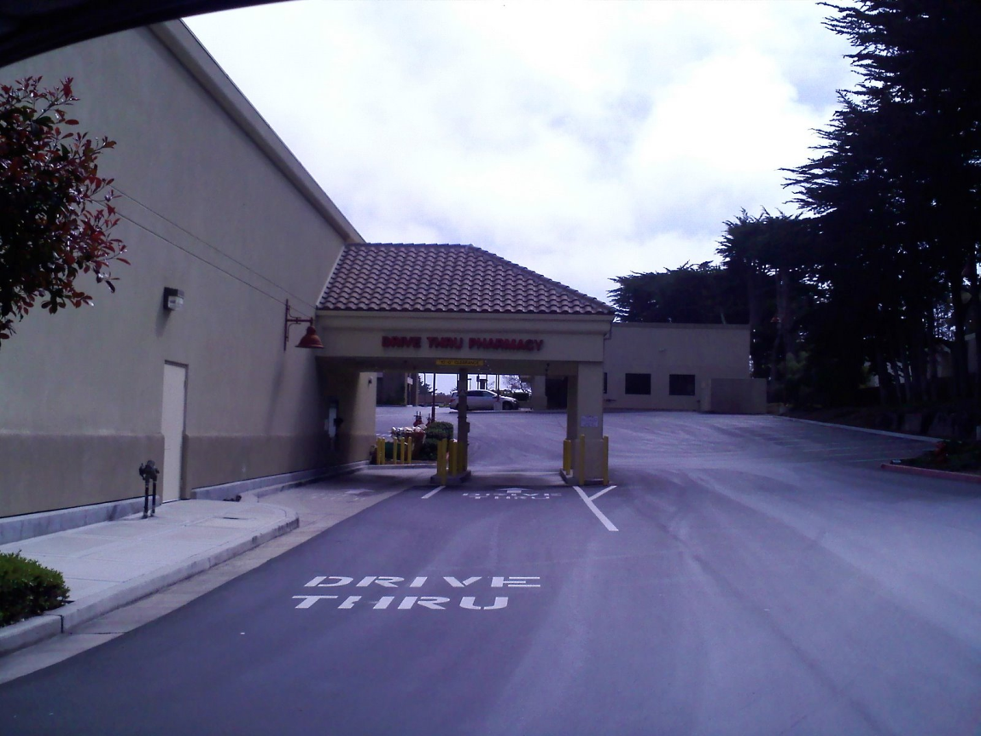
Types of Queuing Systems
Multiple Line Single Phase: Walgreens Drive-Thru Pharmacy

Slide 37
Measuring Queuing System Performance
Average number of customers waiting (in the queue or in the system)
Average time waiting
Capacity utilization
Cost of capacity
The probability that an arriving customer will have to wait and if so for how long.

Slide 38
Queuing Model Analysis
Two simple single-server models help answer meaningful questions and also address the curse of utilisation and the curse of variability.
One model assumes variable service time while the other assumes constant service time.

Slide 39
Three Important Assumptions
The system is in a steady state. The mean arrival rate is the same as the mean departure rate.
The mean arrival rate is constant. This rate is independent in the sense that customers won’t leave when the line is long.
The mean service rate is constant. This rate is independent in the sense that servers won’t speed up when the line is longer.

Slide 40
M/M/1 Model

Slide 41
M/M/1 Queueing Systems
Interarrival times are exponentially distributed, with an average arrival rate of λ.
Service times are exponentially distributed, with an average service rate of μ.
There is only one server.
The buffer is assumed to be infinite.
The queuing discipline is first-come-first-serve (FCFS).

Slide 42
System State
Due to the memoryless property of the exponential distribution, the entire state of the system, as far as the concern of probabilistic analysis, can be summarised by the number of customers in the system, i.
– the past/history (how we get here) does not matter
When a customer arrives or departs, the system moves to an adjacent state (either i+1 or i-1).

Slide 43
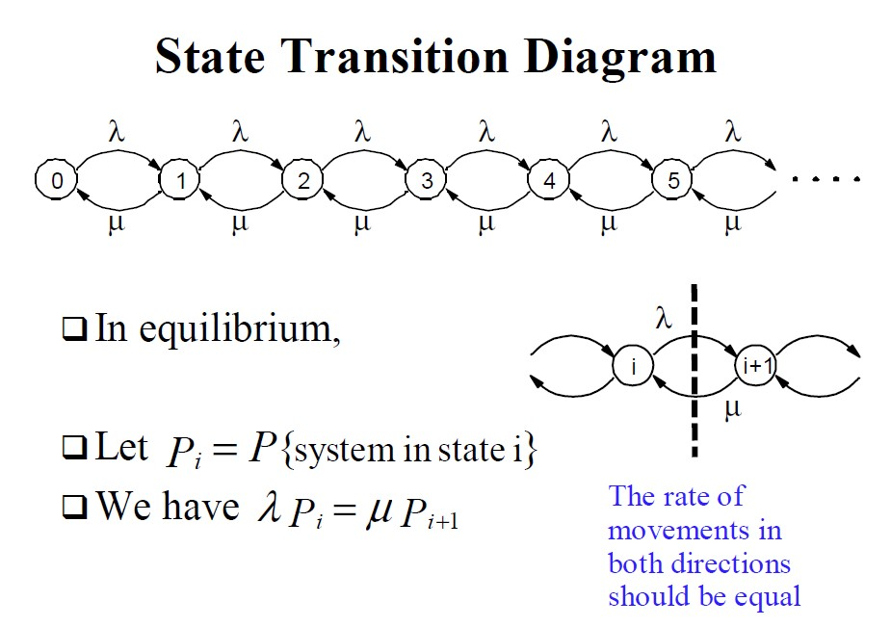

Slide 44
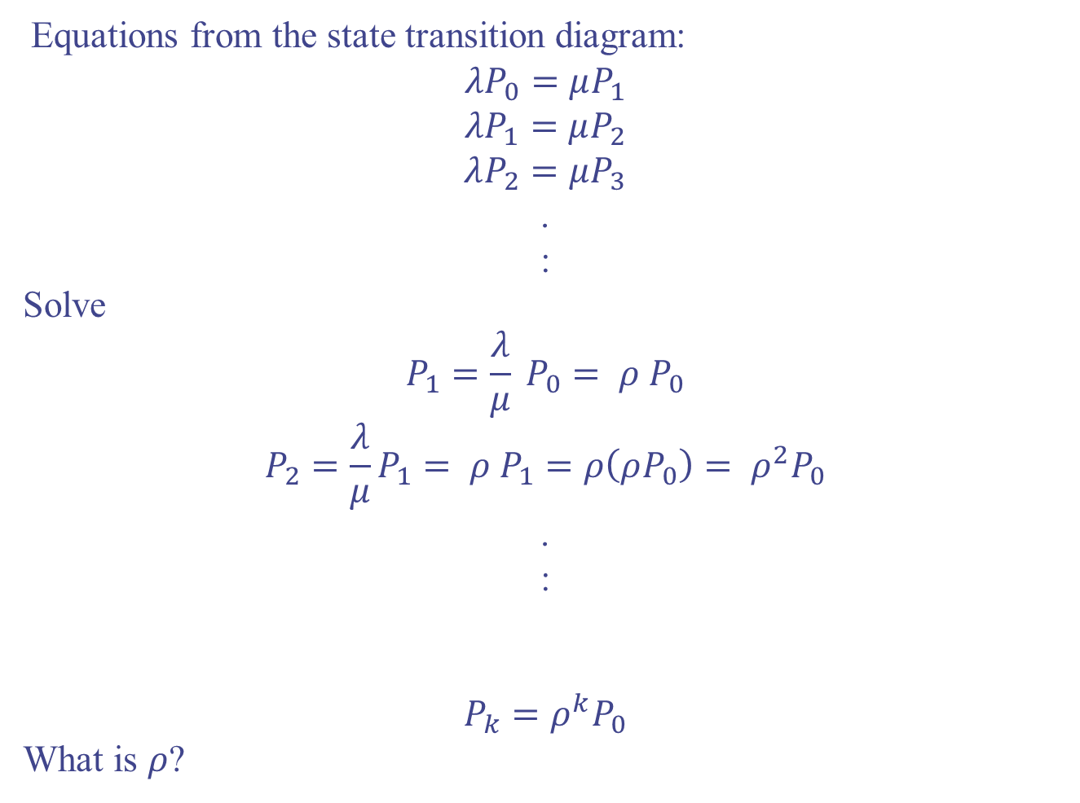
Equations from the state transition diagram:
$$λP_{0}=μP_{1}$$
$$λP_{1}=μP_{2}$$
$$λP_{2}=μP_{3}$$
.
:
Solve
$$P_{1}=\frac{λ}{μ} P_{0}= ρ P_{0}$$
$$P_{2}=\frac{λ}{μ}P_{1}= ρ P_{1}=ρ\left(ρP_{0}\right)= ρ^{2}P_{0}$$
.
:
$$P_{k}=ρ^{k}P_{0}$$
What is $ρ$?

Slide 45
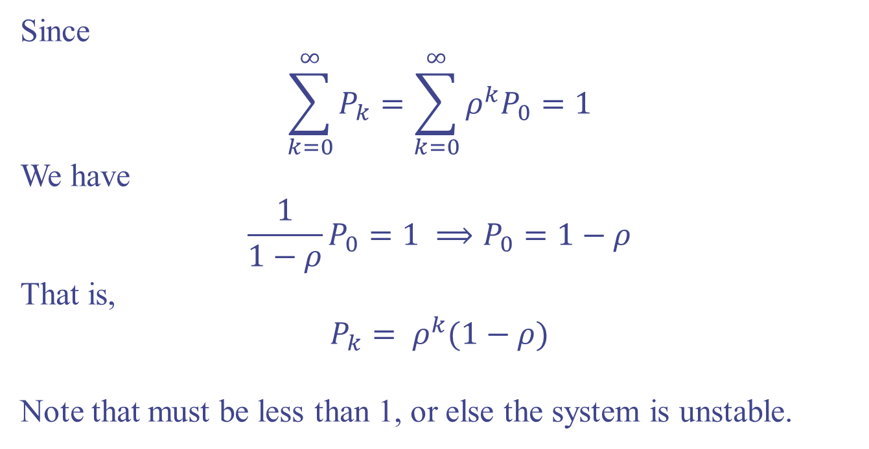
Since
$$\sum_{k=0}^{∞}{P_{k}}=\sum_{k=0}^{∞}{ρ^{k}P_{0}}=1$$
We have
$$\frac{1}{1−ρ}P_{0}=1 ⟹P_{0}=1−ρ$$
That is,
$$P_{k}= ρ^{k}(1−ρ)$$
Note that must be less than 1, or else the system is unstable.

Slide 46
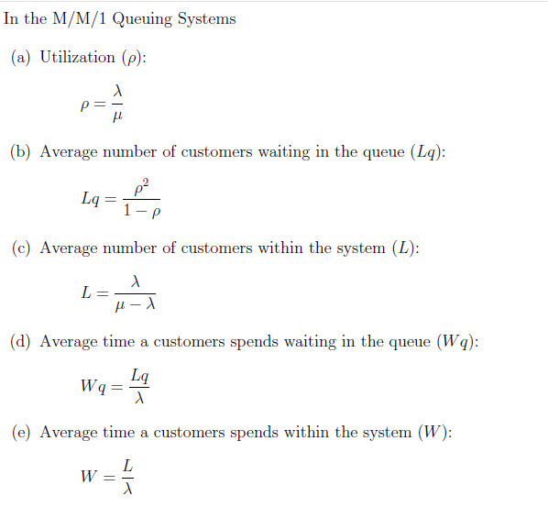

Slide 47
Example 1:
A single-server queuing system follows an M/M/1 model with an arrival rate of 5 customers per hour and a service rate of 8 customers per hour. Calculate the following:
The average number of customers in the system.
The average number of customers in the queue.
The average time a customer spends in the system.
The average time a customer spends waiting in the queue.

Slide 48
In an M/M/1 queuing system, the notation stands for the following:
- M: Exponential distribution for arrivals (Poisson process)
- M: Exponential distribution for service times (Poisson process)
- 1: One server
Given the parameters:
- Arrival rate (λ) = 5 customers per hour
- Service rate (μ) = 8 customers per hour
We can use the following formulas to calculate the requested metrics:
1. Average number of customers in the system (L):
L = λ / (μ - λ)
2. Average number of customers in the queue (Lq):
Lq = (λ^2) / (μ (μ - λ))
3. Average time a customer spends in the system (W):
W = 1 / (μ - λ)
4. Average time a customer spends waiting in the queue (Wq):
Wq = λ / (μ (μ - λ))

Slide 49
Let's plug in the given values and perform the calculations:
Average number of customers in the system (L):
L = 5 / (8 - 5) = 5 / 3 ≈ 1.67 customers
Average number of customers in the queue (Lq):
Lq = (5^2) / (8 * (8 - 5)) = 25 / 24 ≈ 1.04 customers
3. Average time a customer spends in the system (W):
W = 1 / (8 - 5) = 1 / 3 ≈ 0.33 hours (or 20 minutes)
4. Average time a customer spends waiting in the queue (Wq):
Wq = 5 / (8 * (8 - 5)) = 5 / 24 ≈ 0.21 hours (or 12.5 minutes)
So, in this example:
- The average number of customers in the system is approximately 1.67.
- The average number of customers in the queue is approximately 1.04.
- The average time a customer spends in the system is approximately 20 minutes.
- The average time a customer spends waiting in the queue is approximately 12.5 minutes.

Slide 50
Example
In a bank, customers arrive at a rate of 10 per hour, and the average service time is 5 minutes per customer. Find the following:
The average number of customers in the system.
The average number of customers in the queue.
The average time a customer spends in the system.
The average time a customer spends waiting in the queue.

Slide 51
Given the parameters:
Arrival rate (λ) = 10 customers per hour
Service rate (μ) = 1 / (5 minutes per customer) = 12 customers per hour
Let's use the formulas for the various metrics:
Average number of customers in the system (L): L = λ / (μ - λ)
Average number of customers in the queue (Lq): Lq = (λ^2) / (μ (μ - λ))
Average time a customer spends in the system (W): W = 1 / (μ - λ)
Average time a customer spends waiting in the queue (Wq): Wq = λ / (μ (μ - λ))

Slide 52
Now, let's plug in the given values and perform the calculations:
Average number of customers in the system (L): L = 10 / (12 - 10) = 10 / 2 = 5 customers
Average number of customers in the queue (Lq): Lq = (10^2) / (12 * (12 - 10)) = 100 / 24 ≈ 4.17 customers
Average time a customer spends in the system (W): W = 1 / (12 - 10) = 1 / 2 = 0.5 hours (or 30 minutes)
Average time a customer spends waiting in the queue (Wq): Wq = 10 / (12 * (12 - 10)) = 10 / 24 ≈ 0.42 hours (or 25 minutes)
So, in this example:
The average number of customers in the system is 5 customers.
The average number of customers in the queue is approximately 4.17 customers.
The average time a customer spends in the system is 30 minutes.
The average time a customer spends waiting in the queue is approximately 25 minutes.

Slide 53
Example
A manufacturing facility has a single machine that produces a certain product. The arrival rate of jobs to the machine follows a Poisson process with an average rate of 5 jobs per hour. The machine takes an average of 10 minutes to process each job, following an exponential service time distribution. Calculate the following:
The utilization of the machine.
The average number of jobs in the system.
The average time a job spends in the system.
The probability that the machine is idle.

Slide 54
Example
The counter of a bank branch performs the transactions with a mean time of 2 minutes. The customers arrive at a mean rate of 20 customers/hour. If we assume that arrivals follow a Poisson process and that the service time is exponential, determine
Percentage of the time the bank teller is idle.
Mean waiting time of the customers.
Percentage of customers that wait in a queue.

Slide 55
Example
Consider a switch that has an infinite buffer and an infinite number of users generating messages according to a Poisson process with an average inter-arrival time of 800 milliseconds. The switch serves requests with a service time that is exponentially distributed with an average service time of 500 milliseconds. What is the average waiting time? Suppose that the switch is upgraded to reduce the average service time to 400 milliseconds. How would that affect the average waiting time?

Slide 56
Warm-up Examples
A service center receives customer requests at an average rate of 6 requests per hour, following a Poisson process. Calculate the probability that the service center receives exactly 4 requests in a 1-hour period.
A manufacturing plant produces electronic components, and defects occur during the production process. The average rate of defects is found to be 2 defects per hour, following a Poisson process. Calculate the probability that no defects occur in a 30-minute production run.

Slide 57
The traffic Police officer’s radar speed gun causes grief for many drivers who use the Jaffna-Kandy (A9) road. A particular location between Ariviyal Nagar and Iranaimadu junction in Kilinochchi catches 12 speeding motorists per hour. This figure is an average of all hours between 9am and 5pm.
How many motorists would you expect to be caught speeding by the Police officer in any given 10 minutes period? And which distribution would best be used to model the number of speeding motorists in a 10 minutes period?
What proportion of 10 minutes period would you expect the Police officer’s radar speed gun to remain unused to deliver a fine?
What is the probability that the Police officer catches at-least three motorists in 15 minutes period?

Slide 58


Don’t hesitate to contact us if you have any questions about this course’s teaching contents. Also, don’t forget to check out the course page and Microsoft Team folder,
course page Link: https://mayooran1987.github.io/MC9510/
Course page’s QR code
Microsoft Team folder

